Slide 1
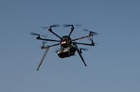
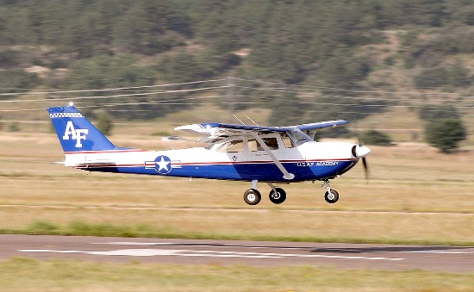
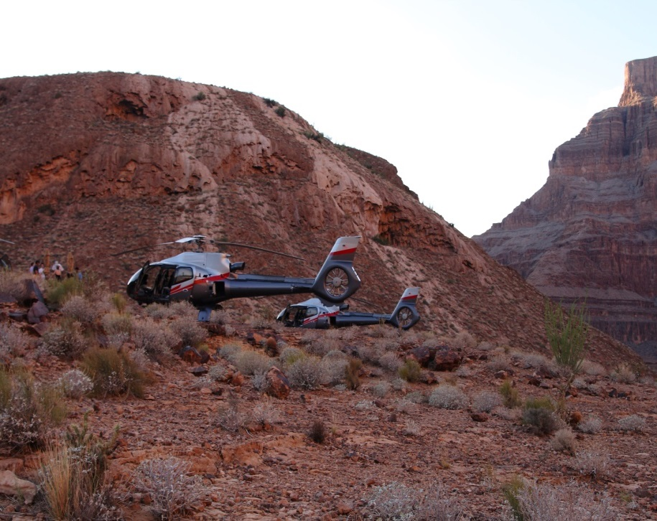
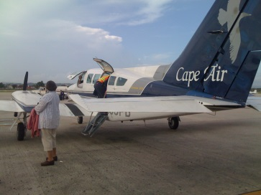




National FAASTeam DronePro November Discussion Slides
Presented to:
By:
Date: November 2021

Slide 2

What’s the story with Rec Flyers notifying airports before flight?
That notification requirement went away in 2018 with the FAA Reauthorization Act (Public Law 115-254)
Since 2018, rec flyers must obtain an airspace authorization before operating in controlled airspace
Airspace authorizations are obtained via LAANC or DroneZone
Must be at or below UASFM altitudes
No airspace authorization needed in Class G airspace
No airport “notification”
See 49 USC 44809 or Advisory Circular 91-57
Notes:
The requirement to notify any airport/heliport within 5 miles of where a recreational flyer was originally created in 2012, but was changed in 2018.
The requirement “to notify” was originally established in Section 336 of public law (PL) 112-95 in 2012, codified in 49 USC 40101, the special rule for model aircraft, and this special rule required model aircraft to “notify” airports and control towers within 5 miles prior to operating. However the 5 mile notification requirement was rescinded by Congress in 2018 with Section 349 of Public Law 115-254, codified in 49 USC 44809. When the law was changed, persons flying under the newly created “limited exception for recreational flyers”, codified in 49 USC 44809 were required to obtain an airspace authorization from the FAA in a manner acceptable to the Administrator before operating in controlled airspace. The FAA has determined that this airspace authorization in controlled airspace (Class B, C, D, and surface area Class E) must be obtained via LAANC or DroneZone (for non-LAANC capable airports), or operated within a Fixed Flying Site.
See AC 91-57 and JO 7200.23 for more information about obtaining an airspace authorization.
Rec flyers (and part 107 operators) do not need an airspace authorization if flying in uncontrolled (Class G) airspace.
Authorization to operate in uncontrolled airspace is provided in 49 USC 44809 (a)(6), and in part 107 (if flying under part 107).

Slide 3

Is public safety exempt from the requirement to use a CAT 2 or CAT 3 compliant (and marked) drone to conduct a CAT 2 or CAT 3 operation over people?
Public Safety is not exempt
Category Operations are part 107
If flying under part 107, a remote pilot, including public safety, may only operate over people with an approved, compliant and marked (if CAT 2, 3, or 4) Category drone, appropriate to the category of operation over people
If flying under a part 91 COA, public safety COAs only allow for flights over people in a life safety (life or death) situation, and only momentarily (not sustained)
Notes:
Under part 107, all operations over people or moving vehicles are now categorized as Category 1, 2, 3, or 4. See 107 subpart D for more information about the rules for conducting an operation over people or moving vehicles. Remember that part 107 is only good for civil drones up to 55 pounds. Part 91 applies to civil drones 55 pounds or more, and public aircraft drones of any weight.
Public safety fly under either part 107, or under part 91, depending on whether they are operating as a civil or public aircraft. See AC 00-1.1B for more information about operating as a public aircraft. When public safety operate as a civil aircraft under part 107 (with a small UAS, for example), they must comply with the part 107 rules just as any other part 107 operator.
Any operation over people or moving vehicles must use a drone that has an FAA approved Declaration of Compliance (DOC), and is legibly marked. As of 19 October 2021 when these slides were made, there are no approved DOC category drones, so the only alternative for ops over people is to use a Category 1 drone, which weighs under 0.55 pounds, and fully complies with Subpart D of 14 CFR part 107.
If public safety cannot fully comply with the appropriate flight rules, and they have an emergency, they should follow the Special Governmental Interest process and obtain a temporary, emergency waiver or authorization from the FAA Systems Operation Support Center. See JO 7200.23 for more information about that process.

Slide 4
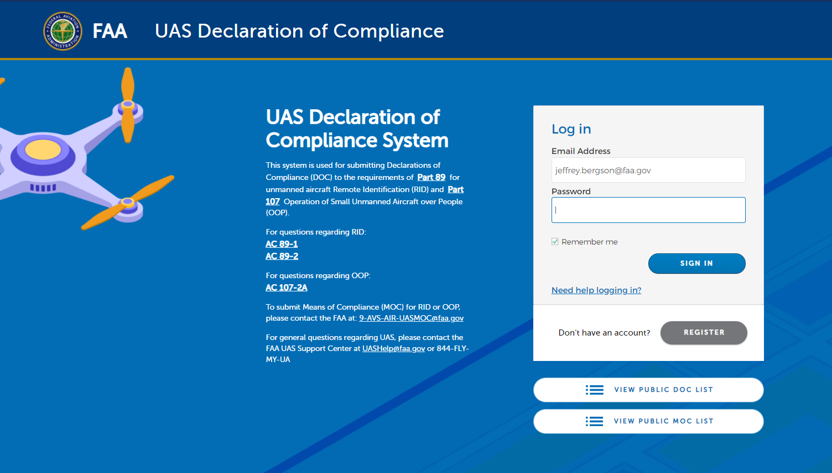
How do I know if my drone is CAT 2 or CAT 3 compliant?
It must be listed on the FAA Declaration of Compliance Accepted webpage
If it’s not listed there, it’s not approved for CAT 2 or CAT 3 ops
CAT 4 ops requires a Type Certificated drone
https://uasdoc.faa.gov
If you want to fly over people today, you can only use a CAT 1 drone since none are approved yet for CAT 2 or CAT 3 (or CAT 4) operations
Notes:
To check if your drone has an approved Declaration of Compliance (DOC) by the FAA, go to the web site shown on the slide. On the bottom right hand side of the landing page is a hotlink to “view public DOC list”. This will list all FAA accepted (by the FAA) drones by make/model and category as well as approved Remote ID modules.
If the drone or RID appliance is not listed as accepted on this page, it’s not approved by the FAA for use.

Slide 5
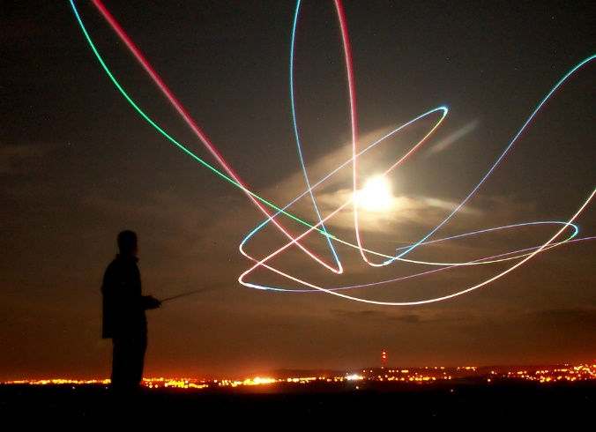
Are waivers to 107.29 (night) still valid?
All waivers to 107.29 were terminated by the FAA as of 17 May 2021
Any part 107 remote pilot can fly at night without a waiver provided
they have completed the updated recency of knowledge training or initial test, and
equipped the drone with anti-collision lighting that’s visible for 3SM
No change to the Part 91 COAs, however
*NOTE: A waiver to 107.29 is still possible but only to waive lighting requirements
Notes:
Prior to the amendment to part 107.29 became effective on 6 April 2021, the FAA provided notice in the Federal Register that all existing 107.29 waivers would automatically terminate on 17 May 2021. This was to allow those waiver holders time to train their pilots and equip their drones to comply with the newly amended regulation.
The amended 107.29 rule allows for part 107 certificated pilots to fly at night provided they have taken the updated training (which includes night topics), and have equipped their drone with an anti-collision light visible for 3 statute miles (SM).
Of significance to part 91 operations, which include all public aircraft operators or civil operators operating drones that weigh 55 pounds or more, the amendment to 107.29 is not applicable to them, since their operation is flown under part 91, and not part 107. Part 91 operations have a Certificate of Waiver/Authorization that have terms and conditions that cover night operations of UAS.
A waiver to 107.29 is still possible mainly to allow applicants to seek relief from the 3SM lighting requirement. This may be of interest to drone light show operators and some law enforcement operators, but these type of applicants are expected to be few in number.

Slide 6

Does 107.29 establish night Visual Line Of Sight (VLOS) criteria?
No. The VLOS criteria are found in 107.31
107.29 essentially establishes pre-requisites to operate at night,
...and gives the RPIC the ability to turn down the intensity of light for safety reasons for that particular flight
107.29 does not establish VLOS criteria at all
107.29 and 107.31 are like apples and oranges
NOTE: The 3SM lighting requirement stated in 107.29 is there so manned aviators can see the drone and maneuver in a timely manner, not so the drone pilot can fly their drone up to 3SM away and claim VLOS
Notes:
Consider taking the audience thru the exact wording of both 107.29 and 107.31 to show that the two regs address two completely different requirements.
The amended 107.29 now allows part 107 pilots to fly at night provided they do some things first. It establishes pre-requisite tasks in order to fly at night. While is does allow the Remote Pilot to reduce the intensity of the lighting during flight for safety reasons, the requirement for Visual Line of Sight (VLOS) is covered in 107.31, day or night, in all conditions. If a remote pilot chooses for safety reasons to reduce the intensity of the lighting, that decision and action to reduce the intensity is done on a flight by flight basis, depending on the conditions and situation for that flight.
107.29 and 107.31 are two very different regulations, like apples to oranges, that cover two very distinct requirements.
Many operators are confused about the 3 Statute Mile (SM) lighting requirement, and erroneously think that allows them to fly the drone out up to 3SM. The 3SM lighting visibility requirement is NOT to allow the drone pilot to fly their drone three miles away. The 3SM lighting requirement is there as a safety mitigation to allow manned pilots to see the drone far enough away to safely maneuver away. Notice that 107.31 VLOS does not differentiate VLOS criteria between day or night. See the slide covering 107.31 for more discussion about what VLOS is, and what it means in practical operation.

Slide 7

What are the VLOS criteria of 107.31?
Throughout the entire flight, with vision unaided by any device other than corrective lenses (spectacles), the Remote Pilot must be able to see the drone well enough to know its:
Notice the reg doesn’t say “...in _____ conditions...”
Location
Altitude
Attitude
Direction of Flight
Observe airspace for other traffic
Not pose a hazard to others
That’s because the VLOS criteria are applicable in all conditions
Notes:
The requirement to maintain Visual Line of Sight (VLOS) in order to see and avoid another aircraft is a fundamental concept when operating aircraft in the National Airspace System (the NAS). It’s not simply a matter of seeing the drone as a speck on the horizon. Both the remote pilot in command and a visual observer (VO) if used, must be in a position to be able to see the drone at all times during flight well enough to determine its Location, Altitude, Attitude, Direction of Flight, and be able to see the surrounding airspace well enough to be certain the drone poses no hazard to other aircraft, or persons or property on the ground. The acronym LAADON is a good memory jogger to aid in remembering the criteria. Even if a VO is performing (exercising) the VLOS duties, the Remote Pilot must still be able to look up at all times during the flight to determine LAADON on their own.
The requirement for VLOS is stated in 107.31. These criteria apply in any conditions, day or night, good visibility or bad. These are performance based criteria, which means the outcome is the driver. Performance based regulations recognize the fact that conditions may change and the distance one can see the drone well enough to determine LAADON can be different for each flight, depending on those conditions.
Look at the Pilot’s Handbook of Aeronautical Knowledge, Chapter 17 for more information on aeromedical factors that effect flight. We know from the night visual illusions and the physiology of the eye that the human eye has much less visual acuity at night or low light conditions. One can infer from this that the distance an operator can see a drone well enough to determine LAADON at night is MUCH LESS than during the day.

Slide 8
Handy UAS References
https://www.faa.gov/uas
UASHelp@faa.gov or 844-FLY-MYUA
FAA Rules are found in Title 14 of the US Code of Federal Regulations: https://www.ecfr.gov/
FAA Advisory Circulars (AC) https://www.faa.gov/regulations_policies/advisory_circulars/
AC 91-57
AC 107-2A

Slide 9
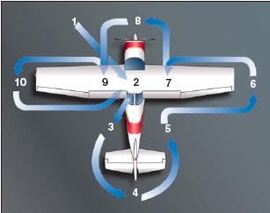
Is a preflight required for a drone flight?
The answer depends on which rules govern the flight
For 49 USC 44809 (Exception for Limited Rec Flyers) flights
49 USC 44809 flights must comply with CBO safety guidelines
See also AC 91-57B for FAA Interim Safety Guidelines
No preflight is explicitly required in 44809
Notes:
The question of whether or not a preflight is required comes up fairly regularly. Whether or not the Federal regulations or US Code requires it, the prudent pilot should always consider risk before flying. Good safety culture suggests that one should always look over their equipment before flight to ensure it will perform as expected. Protecting one’s investment in a drone also suggests that a safety and function check is also a good practice to follow before flying.
49 USC 44809 does not explicitly require a preflight, but it does require the operator to follow the safety guidelines of a Community Based Organization and not endanger the safety of the National Airspace System. Many of those CBOs’ safety guidelines do have a preflight check as part of their guidelines. It may also be good to remind the audience that any flight that does not fully comply with all of the criteria of 49 USC 44809, is governed by 14 CFR part 107, and a pre-flight IS required under part 107.
Advisory Circulars 91-57B and 60-22 Aeronautical Decision Making might be good resources to use when discussing pre-flight planning and risk-based decision making with the rec flying community.

Slide 10
Is a preflight required for a drone flight?
Yes, if it is a part 91 flight
Part 91.7(b) applies to civil operators such as 44807 and SAC-EC flights- No person may operate a (civil) aircraft unless it’s in a safe condition for flight
Part 91.103 applies to both civil and public operators- Each pilot in command shall, before beginning a flight, become familiar with all available information concerning that flight...
Part 91 certificates of waiver/authorization (COAs) also require a preflight “to include specific aircraft and control station systems checks, to ensure the small UAS is in a condition for safe operation”
Notes:
14 CFR Part 91 applies to all public aircraft flights, and all civil flights of drones that weigh 55 pounds or more. Public aircraft are exempt from a few regulations of part 91, but those public aircraft exemptions pertain mostly to airworthiness or airworthiness certificates.
Part 91 requires a preflight for civil aircraft, and all Public Aircraft COAs have a clause in them that require a preflight as well. This was added to the COAs to require public aircraft drone operators to do a preflight even though they don’t have a civil airworthiness certificate.
All part 91 drone flights require a Certificate of Waiver/Authorization (Form 7711) also called a COA, and in those COAs are additional pre-flight instructions.

Slide 11
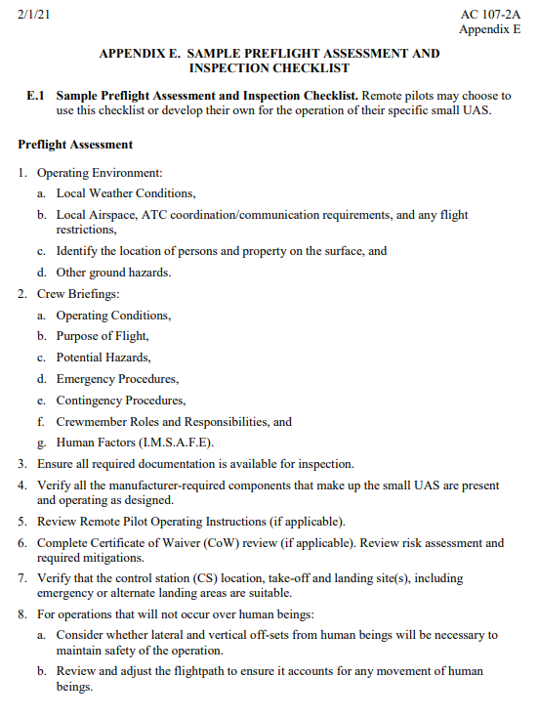
Is a preflight required for a drone flight?
Yes, if it is a part 107 flight
Part 107.49 requires the RPIC to:
Check local weather
Check airspace
Inspect and confirm functionality of drone and GCS
Confirm location of persons and property on the ground
Check for other ground hazards
Brief “crew”, and more....
See AC 107-2A, Chapter 5 and Appendices
Appendix E of AC 107-2A has a three page sample checklist
Notes:
This is a good opportunity to ask the attendees to pull out Advisory Circular 107-2A, and turn to Appendix E and take them thru the significant items that pertain to your area of the country. Like everything else in the AC, this sample checklist is advisory in nature, but good checklists are the key point of emphasis, because they are excellent memory joggers. 107.49 requires the RPIC to check those items listed in 107.49 at a minimum, and that is a regulatory requirement for all flights governed by part 107.

Slide 12

Are there minimum weather requirements for flying a drone?
The answer depends on which rules govern the flight
49 USC 44809 has no weather minimums, but requires the operator to follow the safety guidelines of a CBO or the FAA’s interim guidelines (see AC 91-57B)
Part 91.155 Basic VFR Minimums (depends on which class of airspace)
Part 91 COAs also say 3SM minimum visibility from ground control station (GCS)
Part 107.51(c) says
3 SM visibility from GCS
Minimum distance a drone may be flown from clouds is 500’ below and 2000’ horizontally
Fog is a cloud at ground level
Notes:
Depending on which rules govern the flight, there are different weather criteria that must be met.
A rec flyer fully complying with 49 USC 44809 does not have regulatory weather minimums, per se, but since one of the criteria to fly under 44809 requires the operator to follow the safety guidelines of a FAA-approved Community Based Organization (CBO) or the FAA’s interim safety guidelines, the operator must check and follow those guidelines (or the flight is governed by 14 CFR part 107). Many CBOs have ceiling and visibility minima, for example, but some do not.
Part 91 flights, such as flights flown as a public aircraft, or Section 44807 flights (civil drone 55 pounds or greater), or flights flown under a Special Airworthiness Certificate have weather criteria found in two locations. One is regulation 91.155, which has minima dependent on the class of airspace, and the other is in the terms and conditions of their Certificate of Waiver/Authorization.
Part 107 has weather minima, found in 107.51(c). One criteria that is worthy of discussing with the audience is to remain at least 500’ below and 2000’ horizontally away, from clouds. This essentially means that to fly at 400’ AGL, the minimum ceiling must be 900’ (400+500=900). If someone is planning to fly 400’ above a structure that is 400’ tall, the minimum ceiling must be 1300’ for example (800+500=1300) Flights in or around ground fog are not allowed, as another example.

Slide 13
What’s the difference between a FRIA and a Fixed Site?
FAA Recognized Identification Area (FRIA)
A specific geographic area that drone and operator must remain within, where RID is not required
Tied to the implementation of Remote ID
FAA-recognized CBOs and Educational Institutions may apply for FRIA status
Application review criteria under development
None expected to become established until September 2022 at the earliest
Fixed Site
A specific geographical area in controlled airspace, subject to a Letter of Agreement (LOA) between a RC flying club and the local ATC facility
Fixed Sites are currently in use now, in controlled airspace or where a flying club has an altitude restriction higher than 400’ AGL
Fixed Sites are depicted by small blue circles on the UASFM ArcGIS Map
https://www.faa.gov/go/uasdata
RID will be required to fly here (when RID becomes mandatory)
Notes:
Fixed sites exist today, and many Remote Control modelers operate there, with a Letter of Authorization between the club and the local Air Traffic Control Facility specifying the terms and conditions of that site. Fixed Sites are depicted on the ArcGIS UASFM by a blue circle.
FRIAs are something that’s associated with the implementation of Remote ID (RID).
Fixed Sites will not be exempt from Remote ID. FRIAs will be exempt from RID.

