Slide 1
The National FAA Safety Team Presents
Part 107 Rulemaking Updates
<Audience>
<Presenter>
March 19, 2021

Slide 2
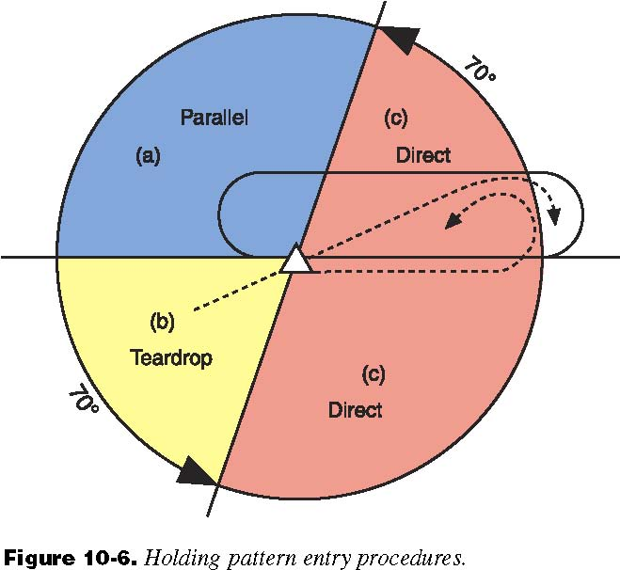
Are the Amendments to Part 107 and the new Part 89 Rule effective now?
No, the effective dates of Part 89 and the amendments to Part 107 were postponed until 21 April (and 6 April), via publication of a notice in the Federal Register
Federal Register www.regulations.gov
Part 89 delay
  RIN 2021-04882
  FAA-2019-1100-53293
Part 107 amendment delay
  RIN 2021-04881
  FAA-2018-1087-0990

Slide 3

Why were the effective dates of Part 89 and the Amendments to Part 107 delayed?
In accordance with the memorandum of January 20, 2021, from the Assistant to the President and Chief of Staff, titled “Regulatory Freeze Pending Review,” the Agency was asked to delay the effective dates to allow time for the new Administration to review the rules for questions of fact, law and policy
It has been common practice for all recent Administrations to do this

Slide 4
Part 89 and Part 107 Amendment Schedule
Final Rules posted on FAA.gov | December 28, 2020
RID and OOP Final Rules published in Federal Register | January 15, 2021
RID and OOP Final Rules Effective Date | April 21, 2021
Recurrent Training Available/Effective On-line | April 06, 2021 (can’t exercise night privilege until effective date of amended 107.29 rule = 04/21/2021)
107.29 Night Waivers Cancelled | May 17, 2021
RID UAS Mfg/Production Compliance Date | September 16, 2022
RID Operational Compliance Date | September 16, 2023

Slide 5

When will the newly revised training for Part 107 recency of knowledge be available on FAASafety.gov?
The effective date for the amendments to 107.65, 107.73, 107.74 was delayed until 6 April
The revised training should be available on 6 April on FAASafety.gov
New Part 107 applicants (not a Part 61 pilot with a current flight review) must still go to an Authorized Knowledge Testing Center and pass the initial TEST

Slide 6

Will the Part 107 recurrent test be offered at the Knowledge Testing Centers after the amendment to 107.65 becomes effective?
The recurrent TEST may be removed from the Knowledge Testing Centers on 6 April, but a firm decision has not been made yet

Slide 7
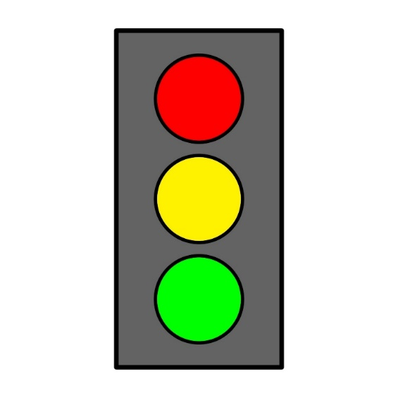
Is there a grace period for remote pilots whose Part 107 recency of knowledge expires before 1 April?
No grace period
Anyone (except Part 61 with a current flight review), whose recency has expired, can either
  Go to an Authorized Knowledge Testing Center (AKTC) and take either the initial or recurrent TEST, or
  Not fly (cannot exercise the privileges of Part 107), or
  Not fly until completing the new recurrent training on FAASafety.gov, available on 6 April

