Slide 1

What is the web address of the NTSB Accident Database?
https://data.ntsb.gov/carol-main-public/basic-search
There are at least 20 UAS related reports in there dating back to 2008
Notes:
These reports might make for some excellent discussion topics, focused on particular findings or observations that relate to aviation safety.

Slide 2

Under Part 107, do any operations over people (OOP) or moving vehicles fall within one of the four categories now?
Have any drones been CATEGORY approved yet?
Yes, anytime a drone is operated over a person or a moving vehicle, and the flight is governed by Part 107, it’s a CAT 1, 2, 3, or 4 operation
  Any person operating over people today under Part 107 must have a Category approved (by the FAA) and marked drone, and may need Remote ID to do that operation, or
  A waiver to 107.39 (and RID if a sustained OOP)
Not yet
Notes:
Many stakeholders mistakenly believe that the recent amendments to Part 107.39 allow for operations over people without conditions. That is not the case.
The amendment to 107.39 imposes significant conditions and performance requirements on any operation over persons or moving vehicles. Those conditions get even more restrictive if flying a CATEGORY 3 operation, or if conducting sustained operations over open air assemblies of people.
Remote ID, for example, while not mandatory for transient operations over people until 2023, is mandatory for any sustained operation over open air assemblies of people. Pilots are expected to plan and execute their flight in a manner that avoids operating over people or moving vehicles, and not create a hazard to others in general. If there is a need to operate over people, the operator must comply with the regulations, which means a category compliant drone, and RID if required. As of June 2021, no category drone Declarations of Compliance have been accepted by the FAA, which means operators may only use a CAT 1 drone, or obtain a waiver to 107.39 before they conduct that operation. Drone Pilots are reminded that CAT 3 operations are prohibited unless operating in a closed set and all within that closed set are made aware of the operation, and the operation must be conducted with a CAT 3 approved and marked drone.

Slide 3
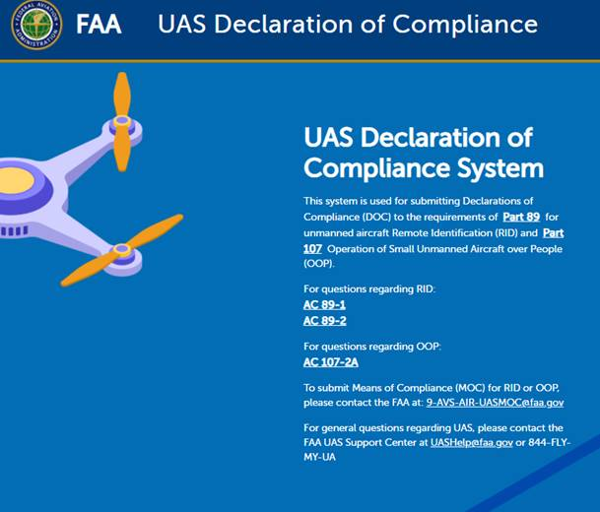
What is the web address and email for the MOC/DOC submission page for RID/OOP?
https://uasdoc.faa.gov
Email: 9-AVS-AIR-UASMOC@faa.gov
Notes:
MOC = Means of Compliance
DOC = Declaration of Compliance
Also point out Advisory Circulars 89-1 and 89-2 for RID MOC/DOC submission guidance and AC 107-2A for MOC/DOC guidance for Ops Over People Category drone submissions.

Slide 4
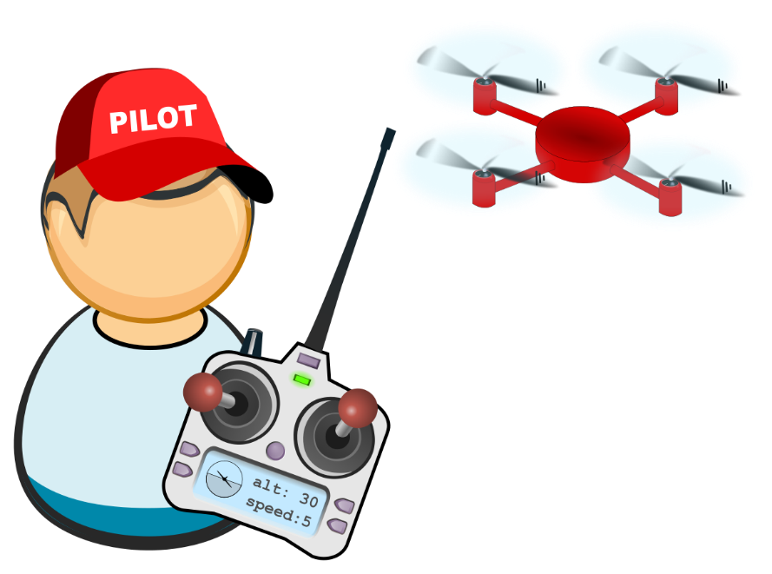
Where should a member of the public go to verify a pilot certificate?
https://amsrvs.registry.faa.gov/airmeninquiry/
The registry does not show Part 107 recency of knowledge or Part 61 flight review currency
Notes:
This web page will only verify if a person has a FAA issued pilot certificate.
Just like manned pilots who do not report the date of their required flight reviews, the FAA does not store nor require the reporting of a remote pilot’s recency of knowledge training completion.
Some pilots have both manned and unmanned certificates. Personally Identifiable Information is not available on this web page. Remote pilots are required to carry their Part 107 certificate with them when they fly, have it easily available, and must present their remote pilot certificate, a photo ID, and drone registration, upon request to the FAA, local, state, and federal law enforcement, the NTSB, and TSA.
If recency of knowledge proof is requested, the remote pilot is not required to show it to local law enforcement, but is required to show it to the FAA upon request. For manned pilots, this is typically done via a logbook entry. Remote pilots are able to print out a FAA Safety Team training course completion certificate of achievement, which would show the date upon which recency of knowledge was obtained. Remote pilots are required to renew their recency of knowledge every 24 months. This is good until midnight on the last day of the month.
If you took the training on May 5th, 2021 for example, the 24 month recency is valid until 1 June 2023.

Slide 5

What is considered VLOS under Part 107.31?
It’s not simply a matter of seeing the drone
It’s a performance based regulation
With unaided vision, you must see the drone well enough to determine LAADON (applies to both day and NIGHT)
  Location
  Altitude
  Attitude
  Direction of Flight
  Obstacle avoidance
  Not pose a hazard to others
Visual acuity is much less at night, so VLOS distance is much less at night
Notes:
Reference Chapter 17 of the Pilot’s Handbook of Aeronautical Knowledge for night flying and Aeromedical Factors that affect flight. This is a great topic to talk about day and night flying, specifically eye physiology, the night visual illusions, preflight planning, and hazards to flight.
Key Learning Points: The VLOS regulation 107.31 is performance based, not fixed distance based. It’s based on safe outcomes rather than rigid distances. Weather, visual acuity, and many other factors may reduce a Remote Pilot’s ability to see the drone well enough to know it’s LAADON.
FPV is allowed, but a VO is required when using FPV, and the VO must be exercising the ability (have actual eyes on it), and the RP must still be in a position where they could remove the FPV goggles, look up, and acquire the drone (be able to).
Visual acuity is significantly reduced at night. Data show that visual acuity for a person with 20/20 vision drops to 20/200 at night, and the ability to see the drone well enough to know LAADON is further complicated by the night visual illusions, and physiology of the eye with the fovea centralis blind spot.
The 3SM lighting requirement is not in the reg to allow the drone pilot to send the drone out 3SM. That requirement is there so manned pilots can see the drone far enough away to maneuver safely.

Slide 6
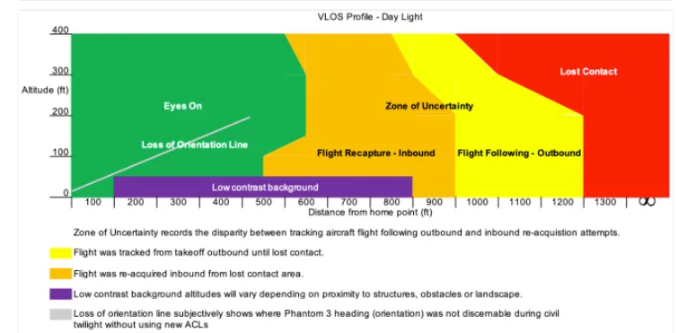
Here’s a great article on VLOS in day/night conditions
https://psflight.org/10479/how-far-can-i-legally-fly-my-drone-and-maintain-vlos-ask-steve/
“...For the Mavic and Phantom 3 the total flight distance under the best of circumstances (in daylight) was less than 1,250 feet if the aircraft was above 200′ Above Ground Level (AGL)”
Notes:
This is a great article to discuss with stakeholders. Many stakeholders do not understand that the 3 Statute Mile visibility of the anti-collision lights for night flight are there for the benefit of manned aircraft, in order to give them time to see and avoid the sUAS. This experiment indicates that once lost, VLOS does not easily get reaquired until much closer to the operator/VO than many believe, even in optimal conditions. Low or no light conditions reduce that LAADON significantly.
Key Teaching Point: To comply with the reg, it’s not enough for the RPIC/VO to simply see the drone. They must see it well enough with unaided vision other than glasses, in both day and night, and in varying conditions, to know it’s Location, Altitude, Attitude, Direction of flight, Obstacle clearance, and the surrounding airspace so as Not to be a hazard to others (in the air and on the ground). This means the distance one can see their drone depends greatly on many factors, and varies from flight to flight. That distance is usually much less than most people think. Given that night visual acuity drops to 20/200 at night, what should a remote pilot expect about his ability to see LAADON at night well enough to comply with 107.31?
The article was not sponsored by the FAA but raises some excellent points that promote a good discussion that should benefit any Remote Pilot to consider when planning their flight.

Slide 7
Who is responsible for registering and marking the drone, the owner or the operator?
§48.15 Requirement to register.
No person may operate a small unmanned aircraft that is eligible for registration under 49 U.S.C. 44101-44103 unless one of the following criteria has been satisfied:
(a) The owner has registered and marked the aircraft in accordance with this part;
(b) The aircraft is operated exclusively in compliance with 49 U.S.C. 44809 and weighs 0.55 pounds or less on takeoff, including everything that is on board or otherwise attached to the aircraft; or
(c) The aircraft is an aircraft of the Armed Forces of the United States.
Notes:
The owner is responsible for registering and marking it correctly, but the Remote Pilot may not operate it (take off) that drone unless he has confirmed it has been properly registered and marked in accordance with Parts 48 (and Part 47 if operating a UAS weighing 55 pounds or more).

Slide 8
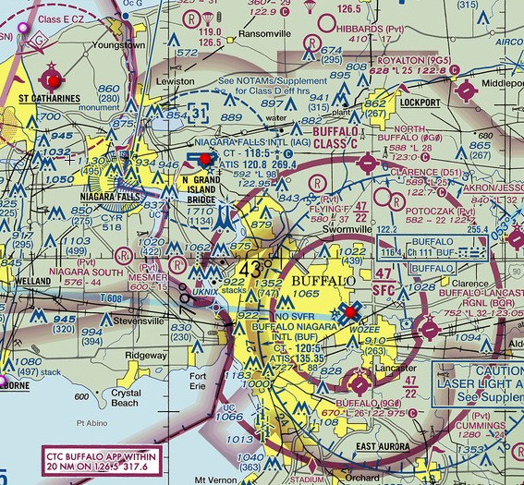
Who should an operator contact if they find a discrepancy with a restricted area in their LAANC USS app?
Reach out to the USS
  Not all USS have Part 93 Restricted Areas on them
Preflight planning includes looking at a VFR sectional and NOTAMS before flight to confirm the airspace
Notes:
The UAS Service Supplier (USS) is the point of contact for any discrepancies noticed by a RP. Many times it’s an issue with that USS app, and not the underlying FAA data.
Remind the audience that proper preflight planning still necessitates a look at the VFR sectional, NOTAMS, and Chart Supplements if operating at an airport.

Slide 9
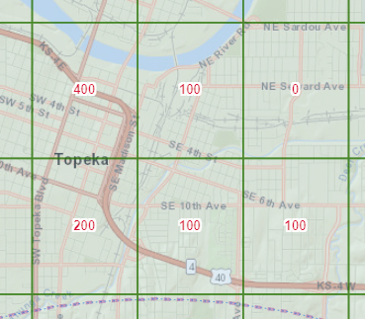
If a LAANC grid altitude says 100’, does this mean I can go 100’ above a structure, or max 100’ AGL?
The published grid altitude is the max altitude above ground level (AGL) that can be flown inside that grid using LAANC when the airspace is Class B, C, D, or Surface Area Class E
If a Part 107 operator wishes to go higher than 100’ in that example, they need to apply for the altitude they want via DroneZone (or wait until the airspace reverts to Class G, if applicable)
Notes:
Green grid squares = LAANC Capable
Red grid squares or no grid squares = Not LAANC Capable (Must use DroneZone)
While part 107.51 allows for a drone to fly up to 400’ above a structure or laterally, that only applies in uncontrolled airspace (Class G). Part 107.41 requires an airspace authorization in Controlled Airspace (B,C,D, and Surface Area Class E) , and that authorization is achieved via LAANC or DroneZone.
A specific altitude is part of that LAANC or DroneZone 107.41 airspace authorization, which is why the altitude in 107.51 is not applicable to certain airspace.
When operating in Controlled Airspace (B,C,D, and Surface Area Class E) those grids represent the maximum altitude an operator can expect to be approved to via LAANC. Some airspace reverts to Class G when the tower closes, and when that happens, then the RP can fly the drone up to 400’ above the structure (when it’s Class G), since LAANC is no longer applicable.

Slide 10
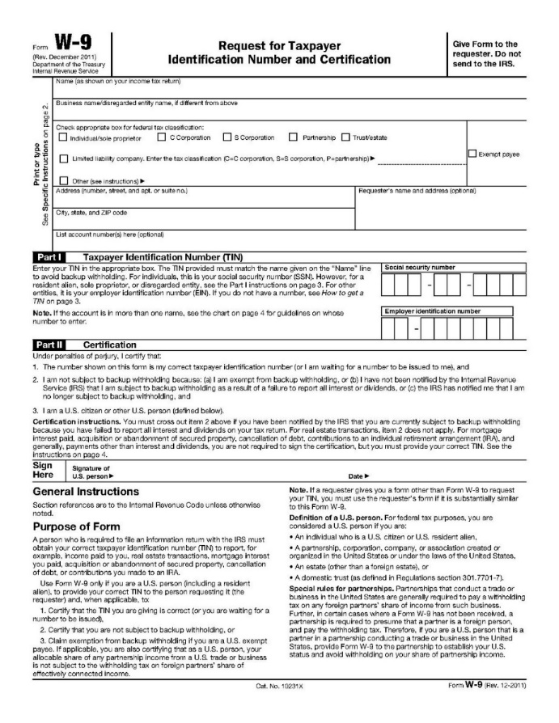
Can the FAA provide a W9 to persons that need one for payment of the drone registration fee?
Yes. Have them reach out to the UAS Support Center and they will coordinate the W9
uashelp@faa.gov
Notes:
Many government entities, and some private/public companies require a W9 before they cut a check. The FAA can provide a W9 upon request to those organizations.

