Slide 1
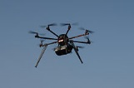
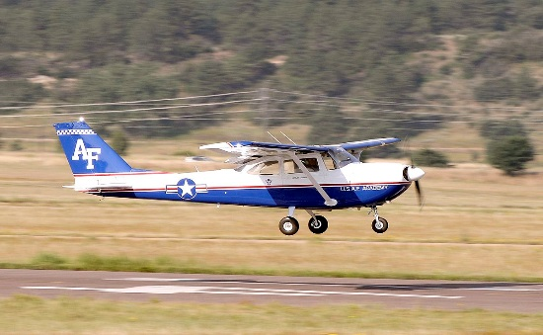
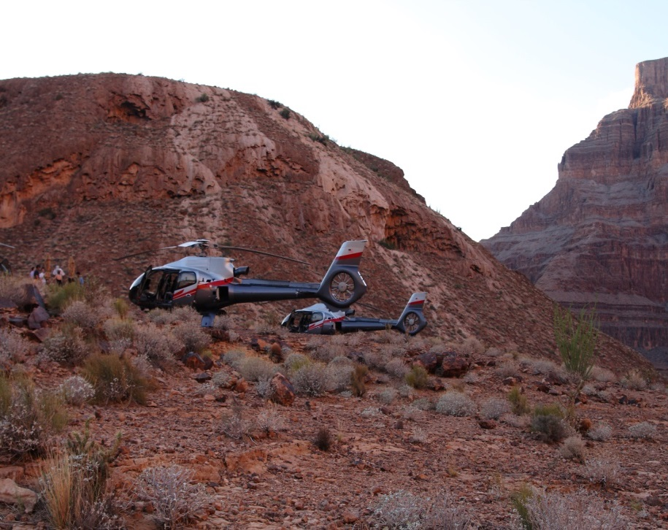
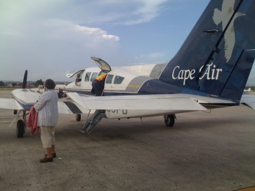
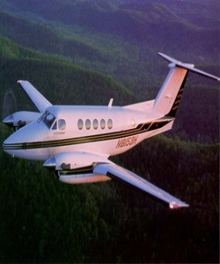
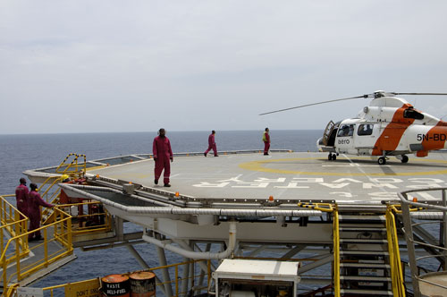
National FAASTeam
Presented to: By:
Date: August 2021

Slide 2
The Recreational UAS Safety Test (TRUST)
Anyone who wants to fly under 49 USC 44809 must complete TRUST
Part 107 certificate holders who wish to fly under 44809, must complete TRUST
TRUST is available now
TRUST is only available online
TRUST is free
There are no age limits
TO TAKE TRUST
Notes:
The limited exception for recreational fliers has a number of criteria that must be met for the person to be able to fly under 49 USC 44809. If the person fails to meet any one or more of those criteria, the operation is governed by part 107, because they are no longer complying with the limited exception (from having to follow part 107). One of the criteria of 49 USC 44809 is to take The Recreational UAS Safety Test (TRUST). That is now available, and anyone who wishes to fly under 44809, must take TRUST. Since TRUST has only recently become available, the FAA does not expect 100% compliance immediately, and relies on DronePros and others to get the word out to educate the stakeholder community that they must take TRUST or may be considered as that flight being governed by part 107. The FAA compliance policy is to get 100% compliance with the appropriate flight rules, since the rules are there for everyone’s safety, and compliance requires some basic level of knowledge. TRUST is a great first step toward creating awareness of the National Airspace System and the flight rules with a community that generally has little knowledge of the NAS and the flight rules.
Part 107 operators are allowed to fly for any lawful purpose under part 107, including for recreational purposes. A part 107 RPIC can fly for recreational purposes under part 107, and must comply with all of part 107 just as with any other flight. If a part 107 certificated operator wished to fly under the limited exception for recreational fliers 49 USC 44809, they must comply with all of the criteria of 44809 just like any other rec flier, which means the part 107 certificate holder must complete TRUST.
There is no upper or lower age limit for TRUST takers. TRUST is free and available online via TRUST Administrators. Once a person completes TRUST, they will receive a digital “token” (an alphanumeric) and must have that available for Law Enforcement, TSA, the NTSB, and the FAA when requested. If a person loses or misplaces their token, they must go back to a TRUST Administrator and retake TRUST and be reissued a “token.” TRUST tokens do not expire. The TRUST is only required once. It’s a “one and done” unless the person loses their token.

Slide 3
Are the VLOS criteria in 107.31 different at night than during day?
The VLOS performance criteria in 107.31 remain the same in all conditions, day or night
With unaided vision, in day or night, you must see the drone well enough to know its
Location
Altitude
Attitude
Direction of flight
Obstacle clearance
Not pose a hazard to other aircraft, nor people and property in the air or ground
Visual acuity is much less in low/no light conditions, so reality is that the distances that one can comply with those criteria are much less
Notes:
Many are confused by 107.29’s reference to anti-collision lights being visible for 3 Statute Miles (SM), erroneously thinking that they can fly their drone out 3SM and still be in compliance with 107.31 Visual Line of Sight. This is incorrect. The 3SM requirement in 107.29 is for other (manned) traffic to see and avoid the drone, not for the drone pilot’s convenience. While anti-collision lights may aid in meeting the VLOS requirements, they cannot be the sole means of complying. Furthermore, the operator may NOT rely solely on the ground control station telemetry data as the means of compliance. Telemetry data can be a good source of confirmation, the requirement is for unaided vision (other than corrective lenses) to look at the drone and see it well enough to determine it’s location, altitude, attitude, direction of flight, obstacle clearance, and not pose a hazard to persons or property in the air or on the ground. The RPIC must be able at all times to put eyeballs on the drone and see it well enough to know this criteria.
The VLOS requirements of 107.31 are criteria that apply in day or night, in any conditions. It is a “performance based” regulation, which essentially means that the distance a person might see the drone well enough is expected to vary depending on the conditions at the time of the flight. Consider an analogy when explaining the concept:
Driving a car in reduced visual acuity in fog, haze, glare from the sun, moisture, humidity, air pollution, smoke. Do any of these conditions merit changing one’s speed vs perfect conditions? Why? Don’t the same concepts apply to flying an aircraft? Sure it does. Seeing and avoiding other objects is a key foundation of the safety of the National Airspace System
When driving a car at night, are hazards more difficult to perceive and react to? Why? This applies to flying aircraft. Drones are aircraft also.
What are the visual illusions in both day and night conditions, that might affect the distance one can determine the VLOS criteria?
How would operating at high elevations effect visual acuity?
How might a person with an astigmatism have to adjust the distance the drone is flown away from them vs someone who doesn’t’ have an astigmatism? Why? How does an astigmatism effect night visual acuity in particular?
VLOS is also a good subject to segue the conversation into aeromedical factors

Slide 4
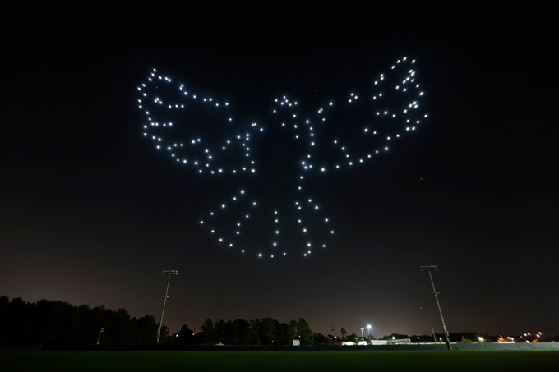
VLOS 107.31 at Night
How far away is the bird image?
What’s the altitude?
Are those lights from drones?
How do u know with vision unaided?
Any visual illusions affecting your confidence?
Notes:
Visual illusions significantly affect one’s ability to determine location, altitude, attitude, direction of flight, obstacle clearance, and the ability to discern if the drone is a hazard to persons or property in the air or on the ground.
Using this example, try suggesting to the audience to make a judgement of how big and how far away that image is if it’s directly over the buildings and street light in the bottom of the picture. How big would that image be if the image were only 50 feet away from you and those buildings and street lights were 3/4ths of a mile away? How would you know definitively with vision unaided? If that image is far away, how high is the highest light? How low is the lowest light? Are there any people underneath those drones? How would you know if you can’t see the area below those drones well enough.
Also discuss the night blind spot, the fovea centralis, and how difficult it is to see an object at night when looking directly at it, vs daylight conditions. This exercise should help demonstrate why distances that an object’s characteristics can be determined at night are usually far less than distances during daylight or clear conditions, and why these criteria are “performance” based (dependent on many factors) and not “prescriptive” (a fixed distance).

Slide 5
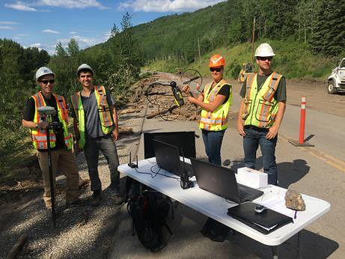
Who are “persons directly participating in the operation...”
See the preamble to part 107 Vol. 81 No. 124, dated June 2016; RIN 2120–AJ60
“The operation” means the sUAS operation itself
It pertains only to the UAS “flight crew”
Not the other firefighters participating in the fire operation
Not the other LEOs working the crash/crime scene
Not the other construction workers
Not the other SAR team members
Not the sports team being filmed
Notes:
This concept is often misunderstood. Many people think “the operation” pertains to the bigger operation that the flight is supporting. When the FAA talks about “the operation”, the FAA means, the flight operation. The persons involved with the flight operation are the flight crew, the RPIC, the VO, are typically the only persons involved in the safe operation of the drone. This has significant implications for operations over people, which are not permitted over anyone except the flight crew without a category approved drone or a waiver.

Slide 6
Have any DOCs/MOCs been approved yet for Ops Over People?
As of 20 August 2021 when this slide was made...
Here’s the website to check the list of approved Means of Compliance and Declarations of Compliance https://uasdoc.faa.gov/login
This means that anyone wanting to fly over people under part 107 today must have a waiver to 107.39, or only use a CAT 1 drone
Notes:
In addition to having a waiver to 107.39, part 89 requires RID if conducting sustained operations over open air assemblies of people. That part 89 requirement became effective in April of 2021, and is in effect today for those who wish to conduct sustained operations over open air assemblies of people.
See 107 subchapter D for the regulations that pertain to operating over people. See part 89 for the regulations that pertain to remote ID of UAS.
In most cases, applying for a declaration of compliance will be done by a drone manufacturer, and they would use either the FAA means of compliance listed in Part 107, or submit a proposed means of compliance for the FAA to review and approve. This is not something an operator self certifies. If the drone’s MOC and DOC is approved by the FAA, it will be listed on this web page. If it’s not listed on this web page, it does NOT have an FAA approved MOC/DOC. Category 4 drones will have a separate process leading to the issuance of a Type Certificate. Again, this is something a company or organization would likely do, and not likely be something done by an individual. However, it is possible for an individual to apply for a MOC/DOC to be approved. There is nothing preventing an individual from applying, however.

Slide 7
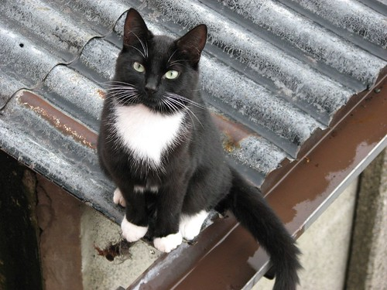
What’s a CAT 1 Drone?
Flown under part 107
Weighs max 0.55 pounds
Weight limit calculation includes all attachments and/or payload
Has no exposed parts that can cause human skin lacerations
No requirement to mark the drone as CAT 1
Additionally, sustained flight over open air assemblies of people requires compliance with part 89 (Remote ID), even for CAT 1 drones
This is a CAT on a hot tin roof
This is not a CAT 1 drone

Slide 8
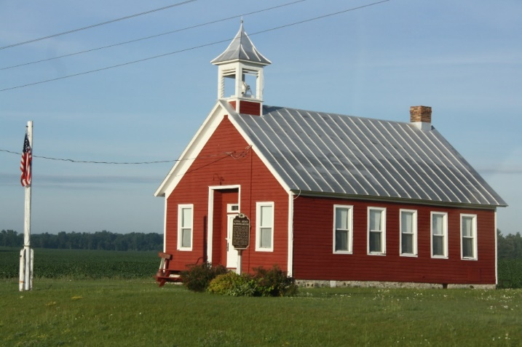
What’s the story on Section 350 of PL 115-254 (in particular, educational use of drones as rec fliers)?
Section 350 is in effect now
“Eligible” program participants can fly under 49 USC 44809
Institutions of Higher Learning listed in section 101(a) of the Higher Education Act of 1965 are eligible
JROTC programs are eligible
Educational programs chartered by a FAA-recognized CBO are eligible (BUT....there are no FAA recognized CBOs yet)
Most primary and secondary schools are NOT eligible for Section 350
Notes:
There has been a lot of interest recently in Section 350 of Public Law 115-254 (the FAA Reauthorization Act of 2018). Section 350 allows some operators to fly as a limited recreational flyer under certain limited conditions.
The law allows for certain “persons” (a person can be an entity or a single person) to follow the criteria of Section 44809 (the limited exception for recreational fliers) instead of part 107 or part 91.
Section 350 is not mandatory. There is no requirement that schools ONLY fly this way. Schools can always operate under 14 CFR part 107 for flights with a sUAS.
Institutions of higher learning are generally post secondary schools such as junior colleges, universities, technical schools. They must meet the criteria listed in the Higher Education Act. There is a list of the types of schools that fall into that category in the regulation.
The FAA will start the process of recognizing Community Based Organizations (CBOs) after the publication of Advisory Circular 91-57C. This process won’t be in place before the 2021 school year is underway, unfortunately.

Slide 9
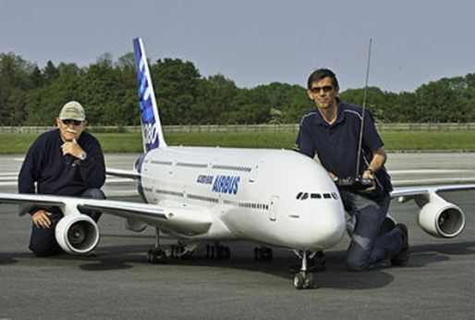
How can a primary or secondary school fly drones today (outside)?
Join a JROTC program, or
Teacher/instructor gets their part 107 certificate
Uncertificated students fly under part 107, under the close supervision of the part 107 certificated teacher/instructor
See 107.12(a)(2)
Another option is to follow the AGC interp that instructor has 107 certificate and students fly as rec fliers (but students must take TRUST in that case)
or wait until they get chartered by a FAA-recognized CBO, and both teacher and students take TRUST, and fly under 44809
When CBOs become recognized by the FAA, getting chartered by a FAA-recognized CBO is an option
Notes:
If an primary or secondary school wishes to fly today, we suggest they consider limiting the flying to indoors, such as a school gymnasium, since the flight rules do not apply to indoor operations. Those are not considered to be part of the National Airspace System, and the FAA doesn’t regulate indoor flights.
Alternatively, the teacher or instructor should get their part 107 certificate and the student may fly under the close supervision of the teacher, and the teacher must be in a position to take control at all times. See 107.12(a)(2) for the regulation that covers that type of flight. In this case, the flight is governed by part 107, and Section 350 is not a consideration.
If the students are gong to fly under 49 USC 44809, they must complete The Recreational UAS Safety Test (TRUST).

Slide 10
UAS in primary and secondary schools
Flying indoors = no FAA rules apply
Nothing prevents students from flying under the direct supervision of a part 107 certificated RPIC (teacher), See 107.12(a)(2)
Section 350 is an option, not a mandate
Remember that to fly under 44809, that person must take TRUST (students included)
Best practice: anyone teaching part 107 knowledge should have a part 107 certificate
Notes:
The FAA does not regulate indoor flights since indoors is not considered part of the National Airspace System
Students can always fly with a part 107 certificated instructor (one student flying paired with one part 107 certificated RPIC). This flight would be governed by part 107, however.
Anyone wishing to fly under the limited exception for recreational fliers must complete TRUST.
If anyone wishes to fly in controlled airspace, they must have an airspace authorization, irrespective of whether or not the flight is flown under Part 107 or Section 44809.

Slide 11
Does LAANC Work for night authorizations now?
LAANC has been modified to allow for night authorizations as of 9 August 2021
UAS Service Suppliers have until 30 September to update their systems
Remember that for any airspace that reverts to Class G, LAANC is not applicable
Grid maps may still show however, but are not applicable when Class G
Notes:
Some airports revert to class G airspace when the tower closes for the evening, for example. When the airspace is Class G, no LAANC approval is needed since the approval to fly in Class G is written into part 107 and section 44809.
The airport facility grid map altitudes are not applicable when the airspace is Class G

Slide 12
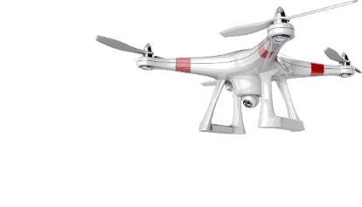
How much is the fee at the Aeronautical Knowledge Testing Center (AKTC)?
The fee is now $175 for the initial UAS part 107 test which must be taken at the AKTC
The recurrent courses are free and available on FAASafety.gov
Notes:
The fee for the initial test has gone up and is now $175. Part 61 certificate holders with a current flight review do NOT have to take the initial test. However, if they do not have a current flight review, then they must take the initial test. There is no cost now for the 24 month recency of knowledge course, found on the FAASafety.gov website.

Slide 13
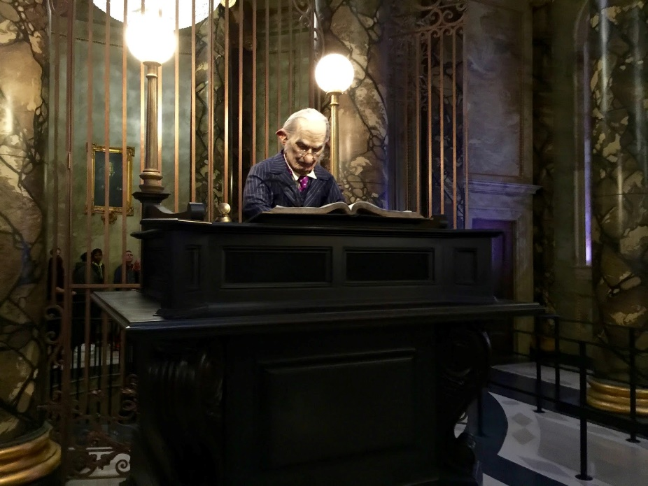
Is the comment period still open for the draft AC 91-57C?
The comment period closed on 9 August
The FAA is adjudicating the comments
Stay tuned for the issuance of the final version of the Advisory Circular
Notes:
The comment period for the draft advisory circular 91-57C has closed and the FAA is adjudicating them. When that process is complete, the FAA intends to publish the newest version of the Advisory Circular 91-57. The current version is 91-57B, and that is still active.

Slide 14
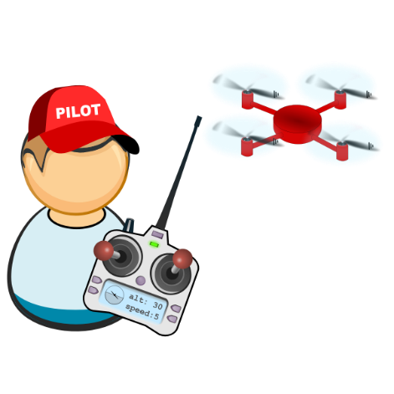
September 13–19, 2021
This virtual safety campaign features events and specially created content and daily themes
Register your event here:
https://dronesafetyawarenessweek.com/
Get more info here: https://www.faa.gov/uas/resources/events_calendar/drone_safety_awareness/
Reach out to your FPM for more information

