Slide 1
UAS Registration

Slide 2
Currency
Information is current as of today
Always check for information changes
Reach out to FPM or UAS Help Desk if needed
Email to UAShelp@faa.gov

Slide 3
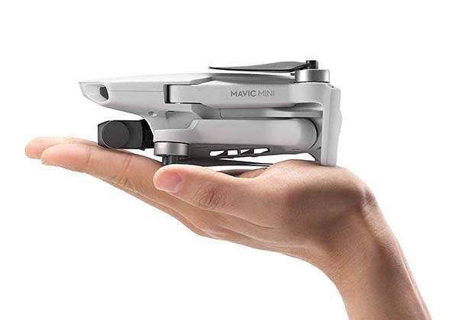
UAS Registration
The Question on everyone’s mind…
Does a drone that weighs 0.55 pounds or less, such as the Mavic Mini need to be registered?

Slide 4
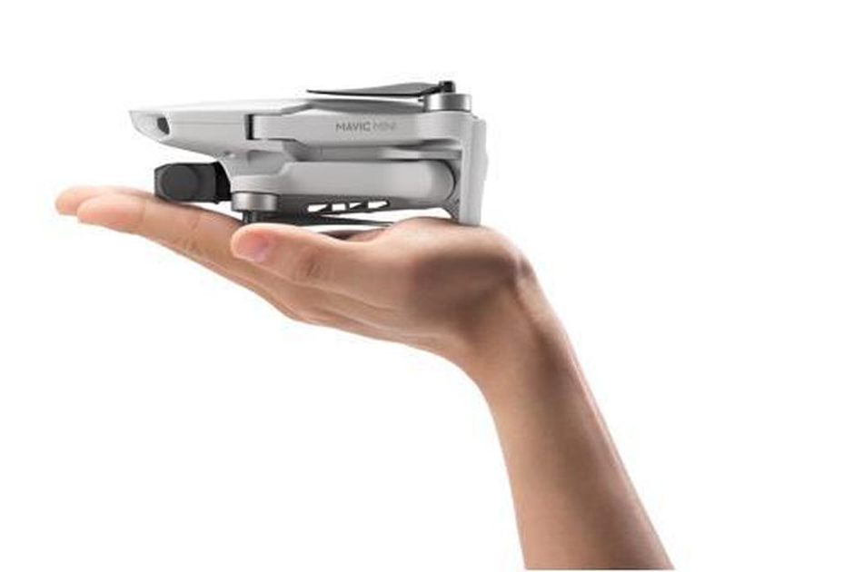
It depends…
Which flight rules apply to the flight?
14 CFR Part 91
14 CFR Part 107
49 USC 44809 Exception for Ltd Rec Flyers

Slide 5
Let’s start at the very beginning…
49 U.S.C. 44102 requires all aircraft to be registered prior to operation
UAS are aircraft, per 49 USC 44801 (11)
There is no weight threshold or limitation in this requirement
In general, all UAS, being aircraft, must be registered, irrespective of weight, but there is an exception
Notes:
Ultralights are not considered aircraft in the CFRs. They are ultralight vehicles, and not subject to registration.
UAS are aircraft

Slide 6
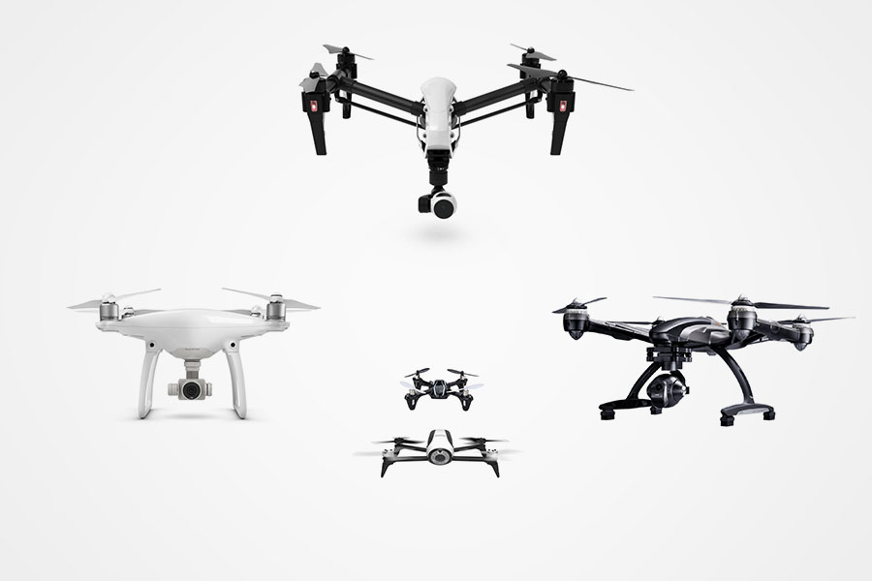
A Refresher on UAS Operating Rules
UAS operate under 14 CFR Part 91 for
Public Aircraft Operations
Grant of Exemption under 44807 (civil UAS 55 pounds or more)
Special Airworthiness Certificate-Experimental Category
Type Certificate
UAS operate under 14 CFR Part 107 for
civil UAS <55 pounds
UAS operate under the Exception for Limited Rec Flyers Section 44809

Slide 7
14 CFR Part 91 Registration
UAS flown under Part 91 must register per § 91.203(a)(2)
“An effective U.S. registration certificate issued to its owner …Application as provided for in §47.31(c), a Certificate of Aircraft registration as provided in part 48, ….”
91.203(a) requires them to have a registration certificate
“Application as provided for in” means how one obtains it, not whether or not it’s required

Slide 8
14 CFR Part 107 Registration
UAS flown under Part 107 are required to register by §107.13
107.13. “A person operating a civil small unmanned aircraft system for purposes of flight must comply with the provisions of §91.203(a)(2) of this chapter”
91.203(a) requires them to have a registration certificate
There is no weight threshold or limit specified in §91.203(a)(2)

Slide 9
49 USC 44809 Exception for Limited Rec Flyers
PL 115-254, Sec. 349 (49 USC 44809)
(8) The aircraft is registered and marked in accordance with chapter 441 of this title and …
Rec Flyers are not governed by §91.203(a), because they are not flying under Part 91 or Part 107, so they can only follow Part 47 or Part 48 to comply

Slide 10
What does Part 48 say?
Look at me! I am a 44809 UAS and weigh 0.55 lbs. or less!
§48.15 Requirement to register.
No person may operate a small unmanned aircraft that is eligible for registration under 49 U.S.C. 44101-44103 unless one of the following criteria has been satisfied:
(a) The owner has registered and marked the aircraft in accordance with this part;
(b) The aircraft weighs 0.55 pounds or less on takeoff, including everything that is on board or otherwise attached to the aircraft; or…
Registration
Here’s one of those “exceptions” for ltd rec flyers

Slide 11
Where to go for more insight
Interim Final Rule (IFR) for Registering and Marking a Small UAS www.regulations.gov
Rule by FAA on 12/21/2015
RIN 2120–AK82
ID: FAA-2015-7396-0004
This interim final rule (IFR) provides an alternative process that small unmanned aircraft owners may use to comply with the statutory requirements for aircraft operations

Slide 12
From the Interim Final Rule Part 48
“Small unmanned aircraft used in non-military public aircraft (i.e. Part 91) operations are subject to the registration requirements of 49 U.S.C. 44101 and as such, must complete the registration process provided in part 47. These aircraft may also be registered in accordance with the part 48 process”
“48.5(b) …Small unmanned aircraft owners authorized to conduct operations other than model aircraft operations (i.e. Part 107) must register the small unmanned aircraft in with part 47 of this chapter. Beginning March 31, 2016, small unmanned aircraft operated as other than model aircraft may complete aircraft registration in accordance with this part”
Nuggets of Gold

Slide 13
Proof of Registration
49 U.S.C. § 44809 Exception for limited recreational operations of unmanned aircraft
(a) (8) …and proof of registration is made available to the Administrator or a designee of the Administrator or law enforcement upon request
49 USC 44103 Registration of Aircraft (d) Certificates Available for Inspection.—
An operator of an aircraft shall make available for inspection a certificate of registration for the aircraft when requested by a United States Government, State, or local law enforcement officer

Slide 14
Summary
Per 49 USC 44102, all aircraft must be registered prior to operation, EXCEPT small UAS flown under 49 USC 44809 (the exception for limited rec flyers) that weigh 0.55 pounds or less, and they have to show it to LE and the FAA upon request
But…
If not fully complying with 49 USC 44809 or the interim guidance, they are governed by Part 107 (or Part 91), which points back to 91.203(a) and requires that the drone must be registered, irrespective of weight, and they have to show it to LE and the FAA upon request

Slide 15
Does a small UAS weighing 0.55 pounds or less have to be registered?
If flying under Part 91, yes
If flying under Part 107, yes
If flying under the Exception for Limited Rec Flyers 44809, no
What rule is the flight (really) governed by?

