Slide 1
Flying During Emergencies
Special Governmental Interest (SGI) Process
Notes:
Introduce yourself
This presentation will educate UAS operators on operating their drones during emergency situations.

Slide 2

Topics
Special process for emergency operations
Who can use the process
How to apply
Real-world scenarios
Notes:
We are going to discuss:
The special process for emergency operations
Who can use the process
How to apply

Slide 3
Special Process for Emergency Operations
Referred to as the Special Governmental Interest (SGI) process
Sometimes called “eCOA” process
Available for:
First responders and other organizations responding to natural disasters
Other emergency situations may be eligible for expedited approval
Notes:
This Special Process for Emergency Operations, is often referred to as the Special Governmental Interest (SGI) process, or eCOA process.
The FAA has established an expedited special process for organizations responding to emergencies, who cannot fully comply with their existing Certificate of Authorization (or COA) or Part 107 regulations for that operation
The operations must directly support an active homeland security, law enforcement, or emergency operations effort, or some other response, relief, or recovery activity benefiting a critical public good – for example, restoration of an electrical grid or some other critical infrastructure, or media coverage of a natural disaster

Slide 4

Special Process for Emergency Operations
If you can fully comply with Part 107 or your COA, go fly!
Notes:
It’s important to remember: if you can comply with Part 107 or your COA, you may operate without going through the SGI process.

Slide 5

Who Does the Process Help?
Public Safety
Utility or Other Critical Infrastructure Restoration
Incident Awareness and Damage Assessment
Disaster Recovery Related Insurance Claims
Media Coverage Providing Crucial Information to the Public
Notes:
This Special Governmental Interest process is designed to facilitate safe and compliant emergency operations by any Part 107 or Public Aircraft entity who serves a legitimate public interest, and who cannot already FULLY comply with the existing regulations, their existing waivers, or airspace authorizations
Typical users of this process are pubic safety, utilities, insurance companies, railroads, Departments of Transportation, Incident Command, Resource Management, Departments of Environmental Quality, Accident investigators, or Media reporting on an event of public interest.

Slide 6

Who Is Eligible to Apply?
Existing Part 107 Remote Pilot
Submit Remote Pilot Certificate number
Holders of an existing Certificate of Authorization (COA)
COA: Entire document and number
Notes:
Remember, if you can fly in full compliance with Part 107 or your existing COA, go fly. No need to call.
You must be an existing Part 107 Remote Pilot or have an existing civil or public COA
If there is a TFR established, such as during a natural disaster, you must be an existing Part 107 Remote Pilot, AND have the support of the on-scene commander on the ground before you submit your application.
For recreational flyers – this process is not available to you – you need to get your Part 107: the reasons are: Congress created an exemption for limited recreational use, and emergency UAS operations are definitely not recreational activity, and secondly, given the likelihood for interaction with manned aviation, the UAS pilots really need to know and comply with the aviation regulations for the safety of everyone involved, and these rules are extensive

Slide 7

Examples of Emergencies
Weather
Active shooter
Localized flood
Bridge collapse
Chemical fire
Notes:
These are just a few examples of emergencies that qualify for the special process.
Weather is perhaps one of the biggest reasons a RPIC might need a temporary, emergency waiver using the SGI process. Remember that both Part 107 and a COA dictate that the weather must be better than 3SM visibility and cloud ceilings must be at least 500 feet above the highest altitude of the intended flight. Many emergencies occur in bad weather and that’s the time to call the SOSC and request a SGI waiver.
Remember… failing to plan for a training mission, is not an emergency.
Now, let’s talk about the information we need to make this happen for you.

Slide 8
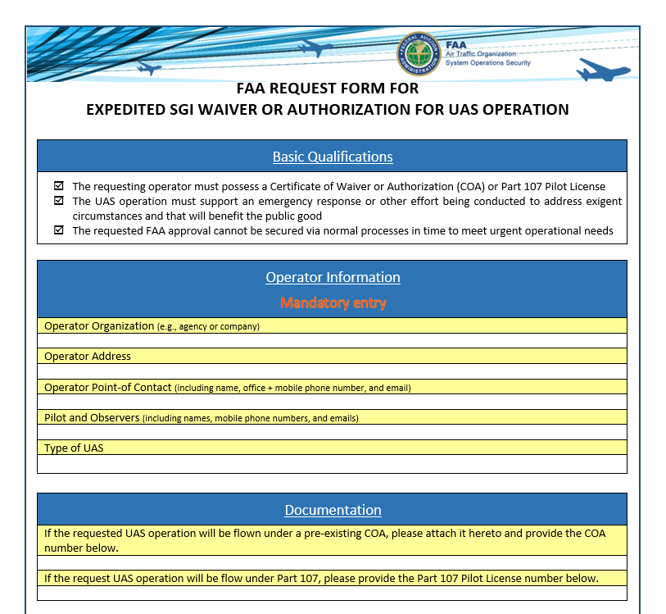
Notes:
This shows the SGI form that the Systems Operation Support Center, or SOSC, will need from you when you make the request.
The first two sections should be pre-filled out and ready to go.
Identify Operator, Pilot and Visual Observer contact information: Name, Office, Mobile Number (if there are multiple pilots or observers you will need to provide information for each person)
We strongly suggest pre-filling in this information so you are ready in an emergency
Consider laminating the form for use in the field, and having hard and electronic copies available with the RPICs and dispatchers as appropriate
Note the RPIC must be certificated, and you must show proof with their RPIC certificate number under Part 107

Slide 9
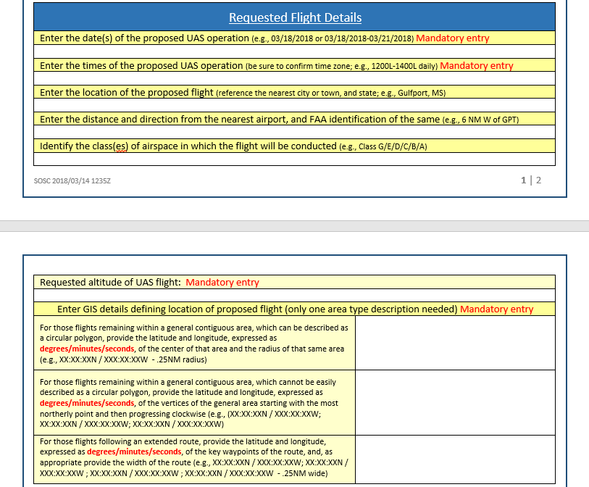
Notes:
Identify proposed flight details: date(s), times, location, distance and direction, class(es) of airspace, and requested altitude (explain to users how they can find and properly fill in this information)
NOTE: many confuse the latitude and longitude information and sometimes use decimals instead of degrees, minutes, and seconds. It’s important to tell the SOSC if you are using decimals rather than degrees, minutes, and seconds so they convert to the correct grid to pinpoint your location. The FAA uses degrees, minutes, and seconds, and assumes the RPIC is also using degrees, minutes, and seconds, FYI Precious time can be lost trying to sort this out if not done correctly
Identify your requested altitude
Show the audience HOW and WHERE to find this information on udds-faa.opendata.arcgis.com or through B4UFLY app or with your LAANC provider.

Slide 10

Submit Application
Email: 9-ator-hq-sosc@faa.gov
Follow up with a call for assistance: (202) 267-8276
Notes:
This is the email address and phone number of the Systems Operations Support Center (SOSC). You can also search “SGI” on faa.gov to get all the information you need.

Slide 11
Tips from the Experts
Don’t wait for an emergency, prepare now!
Have the first two sections of your form completed
Examine and pre-qualify contractor operators
Get additional waivers and authorizations
uashelp@faa.gov
Notes:
Let’s talk about some ways to make the process go smoother or quicker…
Don’t wait for an emergency, start now!
As mentioned before, have your form filled in with the first two sections (so you can get the application done faster in an emergency)
You don’t want to be scrambling for phone numbers and contact information during an emergency
If you’re going to hire drone operators, vet and pre-qualify contractor operators ahead of time, to speed approval.
If you are Part107, consider applying for your 107.29 (daylight operations) waiver now. If you’re a public operator, get your blanket COA now. Don’t wait. – explain why you would want these things!
If you can fly in full compliance with Part 107 or your existing COA, go fly. No need to call.
Help us get the word out to your colleagues who aren’t aware of the regulations and process.
Email uashelp@faa.gov and identify what you’re trying to do, and our Help Desk will connect you with the right resources.

Slide 12

Thank You!
Notes:
Thank you!

